Slide 1
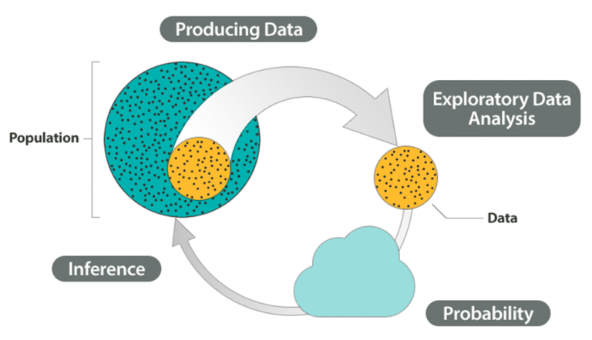
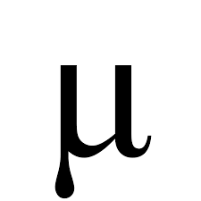
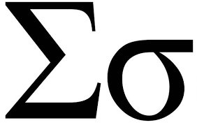
Statistics is the science of gathering, organizing, analyzing, and interpreting information.
Population
of size N
Sample of size n
Variable
Ratio
Interval
Ordinal
Nominal
Quantitative
(Numerical)
Qualitative
(Categorical)
Discrete
Continuous

Slide 2
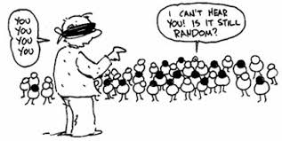
Sampling
Chapter 1 Part 2
Dr. Abolfazl Saghafi
Assistant Professor of Statistics & Data Science
Data Science Program Director
Notes:
You, You, You, and You, not You, yes YOU!

Slide 3
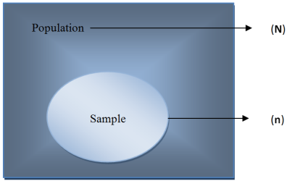
Random Sample
Only when the sample is taken randomly, its results can be generalized to population, otherwise the results are biased.
A random sample of size “n” taken from a population of size “N” guarantees an equal chance selection for each population unit.
Simple Random Sampling (SRS)
Systematic Sampling
Cluster Sampling
Stratified Sampling
Convenience Sampling
Multi Sage Sampling
Notes:
Today, we see how we can properly select a sample from a population, so that the sample is a good representative. Lets say we have a population of size N and we are interested in selecting a sample of size n, first things first, the sample should be selected RANDOMELY, otherwise you are introducing bias to the end results. What we mean by random sample is that each unit in the population should have equal chance of selection.
There are different ways to perform the sampling, the most common are mentioned here.

Slide 4






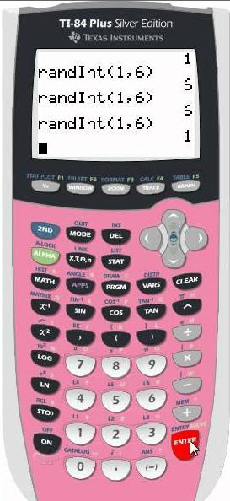
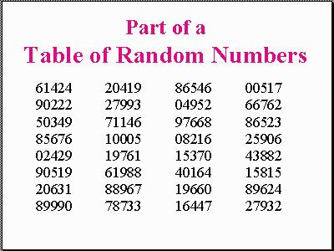
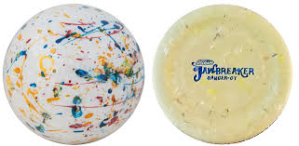
Simple Random Sampling
Population size
N=4
In a simple random sample (SRS)
(1) Each individual has an equal chance of selection
(2) All groups of size n have equal chance selection
1 2 3 4
1 2
1 3
2 3
3 4
1 4
2 4
Sample size
n=2
Notes:
In SRS, aside from equal chance of selection for each individual, all samples should have equal chance of selection. The process is explained in the slides with an example.
To perform such sampling in reality so that the two conditions are guaranteed, we can use raffle drums, table of random numbers, picking names at random from a collection of names, and use the calculator to generate random numbers.

Slide 5
Systematic Sampling
Systematic sampling requires a list of population units.
To perform it
1. Enumerate the population from 1 to N
2. Decide on Sample Size, n
3. Compute k, k ≤ (N/n)
4. Randomly select a starting point
5. Systematically select every kth element
In Systematic sampling every k^{th} individual or item is selected.
N=27
Evenly sampled
Systematic sampling evenly samples the population and is easier to perform than SRS.
Simplicity
n=9
k=3
Notes:
A systematic process is used to select sample units, every k-th unit is called into sample.
This method is used when we have a list of the population units

Slide 6
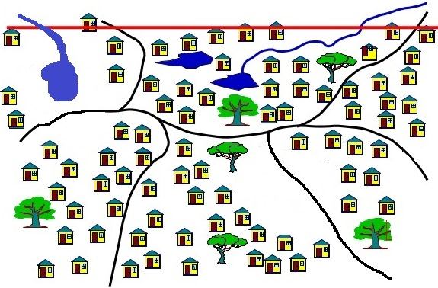
Cluster Sampling
Cluster sampling is used when the population is partitioned into pre-existing clusters, such as zip codes or geographical regions.
To perform cluster sampling, a few of the clusters are randomly selected and ALL units in those clusters are called into the sample.
Notes:
The clusters are already there, we did not create it

Slide 7
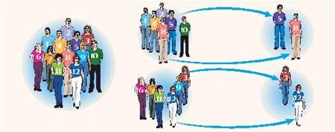
Stratified Sampling
In Stratified sampling individuals are first grouped by specific characteristics such as gender or age by the researcher. Then samples are taken from each group or strata proportional to the group size.
This sampling guarantees proportional representatives from various population groups.
Notes:
We perform the grouping based on some desired characteristics

Slide 8
Convenience Sampling
In Convenience sampling individuals are selected based on ease of access. Such sampling techniques are prone to bias. An example of a convenience sampling is a volunteer response, surveys by phone, etc.
Multistage Sampling
In Multistage sampling more than one sampling technique is employed in information gathering.
For example, first stratify by gender, then systematically take every other individual in each group. Or first cluster individuals by state, then poll these regions using mailers which individuals have the option to fill out at their convenience.

Slide 9




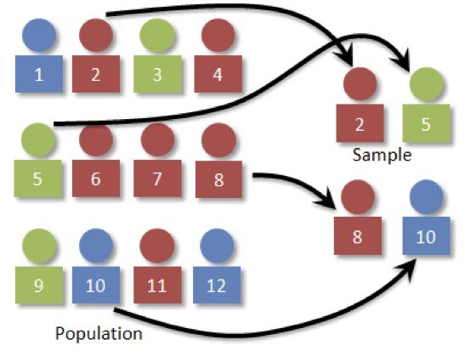

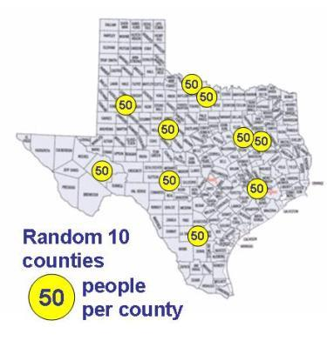

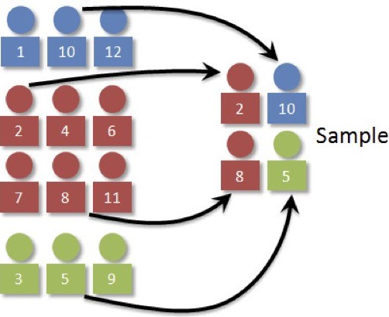
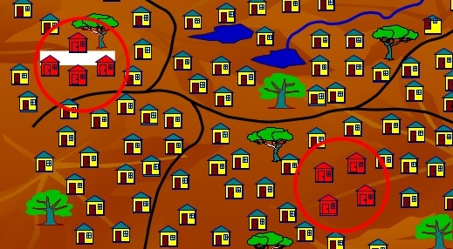
Type of Sampling?
Notes:
Answers:
Top left: SRS
Top right: Stratified
Bottom left: Multistage
Bottom middle: Stratified
Bottom right: Multistage

Slide 10
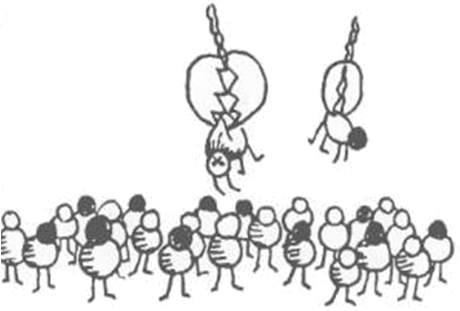
Pitfalls of Sampling
Sampling Error
Hidden Bias
Survey Error: leading questions
Under-coverage: when some members of the population are inadequately represented in the sample
Incorrect Arithmetic
Implausible Numbers: processing errors (entering etc.)
Missing Information
Notes:
Sampling comes at a price
Different types of errors we see in sampling include
Hidden Bias: greater height, lower salary
Survey Error: The government should force you to pay higher taxes

Slide 11
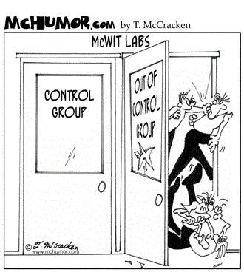
Experimental Design
Chapter 1 Part 2
Notes:
Even before we start the sampling part we need a plan, we need to determine how to perform the study in order to achieve the goals, we need to design the whole process from the beginning.
Some different designs to consider are Census, Sample Survey / Questionnaire, Experimental study, and Observational study

Slide 12


Census & Sample Survey
A census is a survey of every individual in the population and the information gathered is called the population data.
Information from the census allows the public, businesses, governments and communities to make decisions, plan and invest for the future.
US Census Bureau
In a sample survey only some of the individuals in the population are selected, the information gathered is called the sample data.
Notes:
But in most cases the population size is large, study the whole population is time consuming and expensive.
https://www.census.gov/

Slide 13
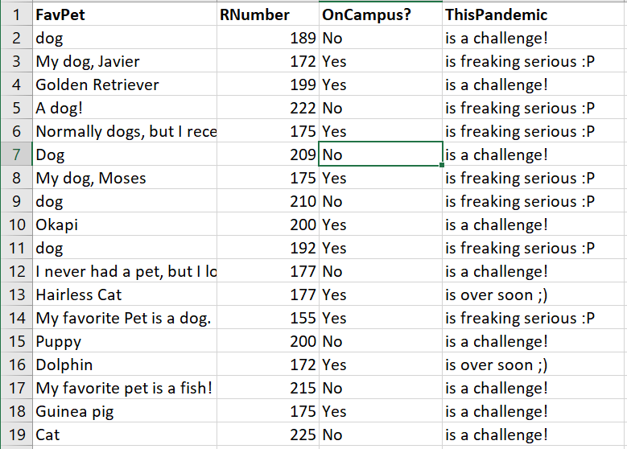
Notes:
Example from class survey, please participate if you haven’t already filled out the survey

Slide 14
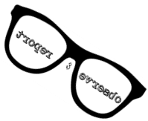
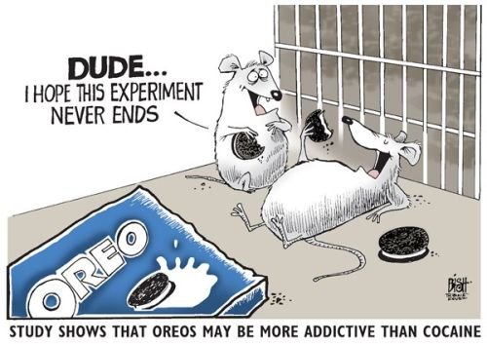
Observational & Experimental study
An observational study is designed to observe without interference from the observer, every effort is made not to sway the subject response or lead a subject in their response.
An experimental study is designed to be observed with interference from the observer in that specific treatments are applied to the individuals, in an effort to measure differences in the subject response.
Notes:
For example, in testing drugs, we assemble two groups similar in effective attributes such as age/gender/medical records, test the drug on one group and use a fake drug on the other.
Between where you sit in the classroom and your final grade? Between the type of animal you like and your birth date? I didn’t have control over participants, they could have different backgrounds in the subject,

Slide 15
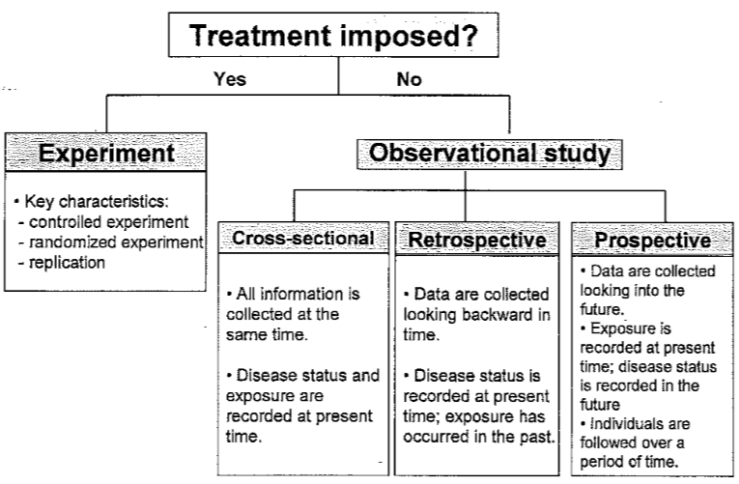
Notes:
Observational studies are either
Retrospective: Use only Historical data (past), hospital files on patients through time
Cross-Sectional: Use data from a Single point in time (present), have a sample of water from a lake, study for unusual substances
Prospective: Data gathered over an extended period of time (future), with a future look, the study continues into the future, study on effects of smoking
Experimental studies have three key characteristics

Slide 16
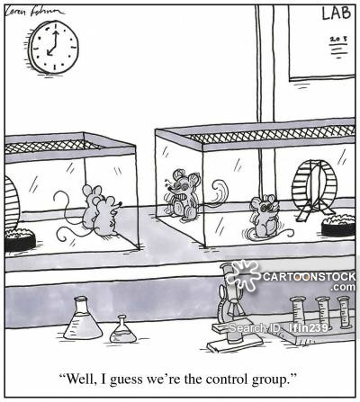
Control Group & Placebo
A control group is a group created for sake of comparison.
This group can be one of the treatment groups or a group that receives a false treatment called a placebo.
The placebo effect occurs when a subject receives a false treatment (such as a sugar pill) or no treatment, but (incorrectly) believes he or she is in fact receiving treatment and responds favorably.

Slide 17
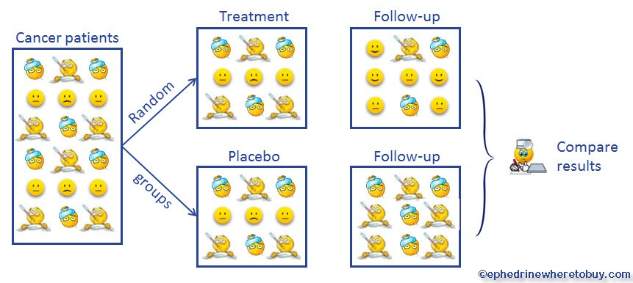
Randomized Trial & Replication
Randomized Trial: The investigators determine who receives the treatment (intervention or agent) and who does not by a random process.
Replication: There should be more than one patient in each treatment group.

Slide 18
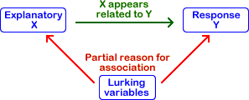
Explanatory & Response Variable
The Response Variable is the outcome of a study. A variable you would be interested in predicting or estimating. Also called a dependent variable.
A Explanatory variable Any variable that explains the response variable. Often called an independent variable or predictor variable.
A confounding variable also known as confounding factor, a lurking variable, a confound or confounder is an extraneous variable that is associated positively or negatively with both the explanatory variable and response variable.
Notes:
Smoking and Lung cancer, gender or age
Can you think of any lurking variable for the smoking example aside from what is mentioned?

Slide 19
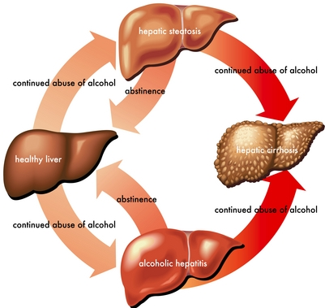
Practice Problems Part 2
Clearly determine the variables, their type, and the study type.
1. In a study about liver disease and alcohol consumption, all patients in a community who had newly been diagnosed with liver disease were recruited and people without liver disease were selected at random from the community to act as controls. All of the cases and controls were then asked about their alcohol intake in the past.
Type of Study: Retrospective Observational Study, since disease status (liver disease or not) is measured at present time and we look for the exposure to the risk factor (alcohol consumption) in the past
Variable(s): Liver disease (Yes, No);
Alcohol consumption (could be Yes/No or Amount)
Notes:
Time to practice, try your best, think before answering, refer back to the slides and study if you don’t know the answer. Answers are provided in Ch1 Practice Problem Solutions

Slide 20
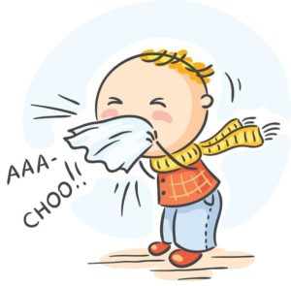
Practice Problems Part 2
Clearly determine the variables, their type, and the study type.
1. In a study about liver disease and alcohol consumption, all patients in a community who had newly been diagnosed with liver disease were recruited and people without liver disease were selected at random from the community to act as controls. All of the cases and controls were then asked about their alcohol intake in the past.
2. Forty USP students participated in a study on colds. 20 were randomly assigned to receive vitamin C, and the remaining 20 received a fake pill. The students were followed for 2 months to see who came down with a cold and who did not.
Notes:
Time to practice, try your best, think before answering, refer back to the slides and study if you don’t know the answer. Answers are provided in Ch1 Practice Problem Solutions

Slide 21
Practice Problems Part 2
4. A group of pediatricians follows a group of babies who are breastfed for six months following birth compared to another group of babies who are not breastfed for six months following birth. The pediatricians want to determine if there is a difference in the chance of developing croup between the two groups over this six-month period.
5. Eight hundred patients with newly diagnosed membranous nephropathy (a kidney disease) were treated with the experimental drug sirolimus, or with a standard drug treatment. The treatment for each patient was chosen by the flip of a coin. Neither the doctor nor the patient knew which drug had been chosen. The outcome measurement was the development of kidney failure.
6. A study on raloxifene and incidence of fractures was conducted among women with evidence of osteoporosis. The women were randomly assigned to the treatment group that received raloxifene or to the control group that received a placebo. The women were then followed for three years to determine the incidence of new vertebral fractures.
Notes:
Answers are provided in Ch1 Practice Problem Solutions

Slide 22


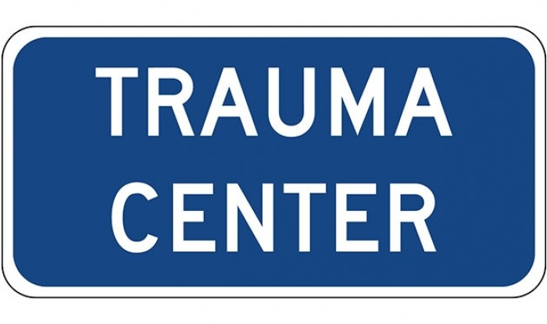
Practice Problems Part 2
Clearly determine the population, sample, and the sampling technique.
1. The Department of Agriculture wishes to investigate the use of pesticides by farmers in England. The researchers identify the different counties in England and select a random sample of 50 of those counties. From each of the selected counties, the researcher randomly selects 25 farmers.
2. Hospital trauma centers are given ratings, on a scale of 1-4, depending on their capability to treat various traumas (1=highest level of available trauma care; 4=lowest level of available trauma care). We are interested in estimating the survival rate of trauma victims treated at hospitals and we are aware of the fact that the trauma level of available care may affect it. For this reason, we decide to randomly select 100 patients from each trauma level of available care (levels 1-4).
Notes:
Answers are provided in Ch1 Practice Problem Solutions

Slide 23
Practice Problems Part 2
3. A group of students want to investigate how common is binge drinking among young people. They prepare a survey and send it to their friends on Facebook.
4. Medical researchers following living organ donors classify donors according to whether they donated a kidney, a portion of the liver, a portion of the lung, bone marrow, or blood. The general health of 200 donors randomly selected from each category is monitored for five years.
5. A local restaurant wants to know which form of advertising (Print, Radio, or Television) will reach the most costumers. Every 10th costumer entering the restaurant is surveyed.
6. A local fast food company wants to know which form of advertising (Print, Radio, or Television) will reach the most consumers. The population of consumers is divided into four geographic regions (West, Midwest, East, South). Two regions are randomly selected and every consumer from the two selected regions is surveyed.
Notes:
Answers are provided in Ch1 Practice Problem Solutions
You’re on the right track, don’t forget to do the homework assignments on Bb, due date is close

